Slide 1
EPC – mission and strategy
29 October 2025

Slide 2
About the EPC
The European Payments Council (EPC) is an international not-for-profit association representing payment service providers (PSPs) across Europe.
Our core mission is to support and promote the harmonisation, integration and development of European payments, with a key focus on the Single Euro Payments Area (SEPA).
At the heart of our work, we manage payment schemes such as SEPA (Instant) Credit Transfer, SEPA Direct Debit, One-Leg Out Instant Credit Transfer, SEPA Request-to-Pay, SEPA Payment Account Access, and others, ensuring smooth coordination with stakeholders across Europe.
As the central voice for European PSPs, we engage in ongoing dialogue with regulators and stakeholders to drive the evolution of payments. Our five EPC payment schemes are the backbone of European payments, facilitating over 50 billion transactions annually for thousands of PSPs.
EPC NUMBERS
3,600 EPC scheme participants
83 EPC Members (PSPs and EU/ National PSP associations)
50+ Bln of SEPA transactions per year (2023, ECB data)
41 SEPA countries
EPC PRODUCTS
5 payment schemes: SCT, SCT Inst, SDD Core, SDD B2B, OCT Inst
3 payment-related schemes: SRTP, SPAA, VOP
2 community ICT services: MISP (Fraud-prevention), EDS (Directory Service)

Slide 3

SEPA 1.0, 2.0, and 3.0!
IPR amending the SEPA regulation and making Instant payments mandatory
OCT Inst first EPC scheme addressing international payments beyond SEPA
VOP first massive adoption API-based scheme
EDS first time for the EPC to take an IT operating role
FRIDA fraud info sharing scheme
API STF first time for the EPC to approach API standardisation in a strategic way
New requirements stemming from the market, geopolitical situation, Overseer, Regulator, stakeholders, …
Instant Payments @POI
Need to better orchestrate the ecosystem (CSMs, RVMs, API standardisation)
Greater emphasis on Fraud prevention (FRIDA)
Evolution of VOP / EDS / OCT Inst; stablecoins; eIDAS
New leadership
➔An EPC strategy refresh for next 3-5 years is required.
“Crown Plaza declaration”
The EPC plenary commits on the SEPA objective and on delivering Credit Transfer and Direct Debit schemes
2008: SCT scheme launched
2009: SDD Core and B2B schemes launched
2005
2002
2008/9
2023-25
Creation of the EPC
Launch of VOP and EDS
2012
SCT Inst scheme launched
2020-23
“SEPA End-date Regulation” mandating SCT/SDD schemes in the Euro Area and EU-27
2017
Launch of SRTP, SPAA, OCT Inst
1.0
2.0
3.0

Slide 4
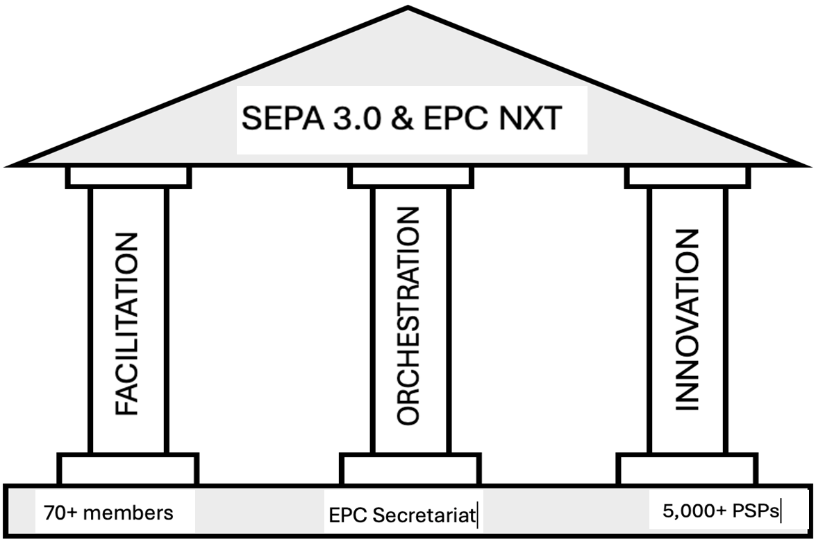
SEPA 3.0
Our mission, within EPC’s statutory mandate, is also to foster resilience and autonomy of European A2A payments, based on three pillars:
Facilitating the SEPA A2A online and @POI payments based on SDD/SCT/SCTinst
(example: further evolution of SCTinst Scheme)
Orchestrating the cooperative space of SEPA A2A payments ecosystem
(example: coordination of VOP implementation)
Innovating the cooperative space of SEPA A2A payments together with our members and stakeholders, including the way the EPC fulfills its scheme management role
(example: development of the Electronic Directory Service)
SEPA 3.0

